Slide 1
OS Introduction 7 Computing Environments
David Liu
Fall 2021, Spring 2022

Slide 2
Learning Objectives
Discuss the role and importance of operating systems
Describe the general organization of a computer system and the role of interrupts
Describe the components in a modern, multiprocessor computer system
Illustrate the transition from user mode to kernel mode
Discuss how OS manages computing resources
Distinguish between protection and security
Describe common data structures for OS
Discuss how operating systems are used in various computing environments
Provide examples of free and open-source operating systems

Slide 3
Contents
Traditional Computing
Mobile Computing
Client-Server Computing
Peer-to-Peer Computing
Cloud Computing
Real-Time Embedded Systems
Hadoop and Spark

Slide 4
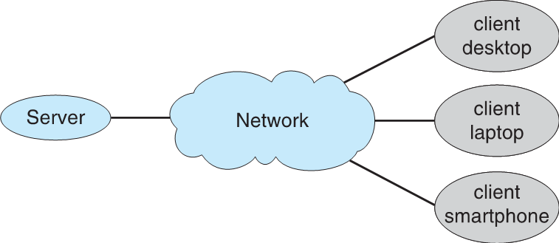
Client-Server
Request and Reply

Slide 5
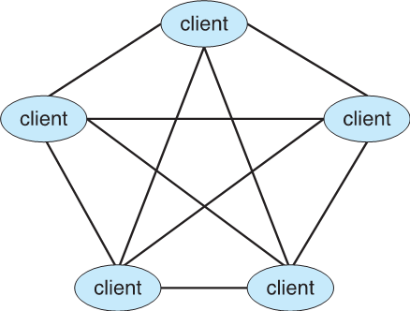
Peer-to-Peer
Register service
Discovery protocol

Slide 6
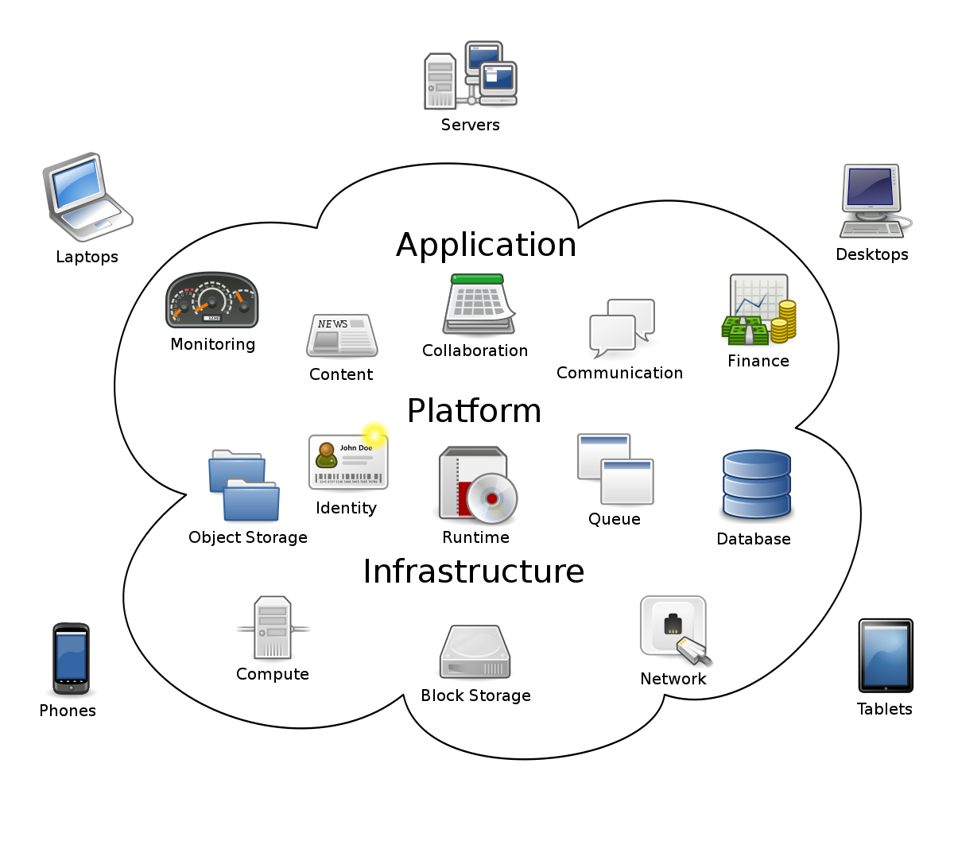
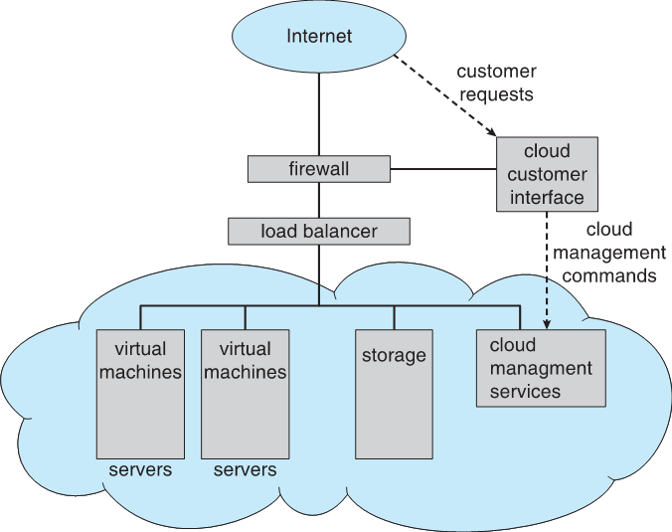
Cloud Computing
IaaS, PaaS, SaaS
Virtualization
Public, private, hybrid
IaaS

Slide 7
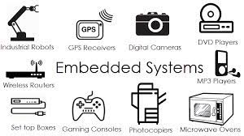
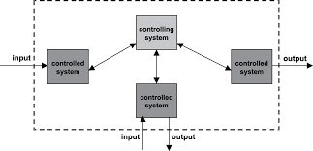
Real-Time Embedded Systems
Correct Operation only within fixed time

Slide 8
Hadoop
an open-source software utility that allows users to manage big data sets (from gigabytes to petabytes) by enabling a network of computers (or “nodes”) to solve vast and intricate data problems.

Slide 9
Spark
An open-source data processing engine for big data sets and performs faster than Hadoop and it uses random access memory (RAM) to cache and process data instead of a file system.

Slide 10
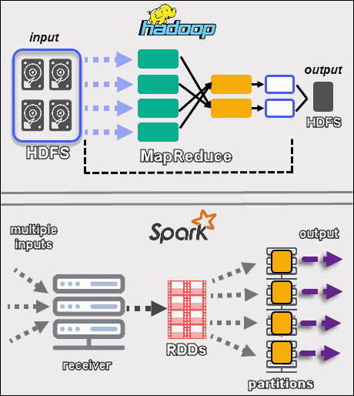
Hadoop vs Spark

Slide 11
Free and Open-Source OS
Free software → Open source
Open source
GNU/Linux
Closed source
Microsoft Windows
Hybrid source
Apple macOS
Which one is more secure? Why?

Slide 12
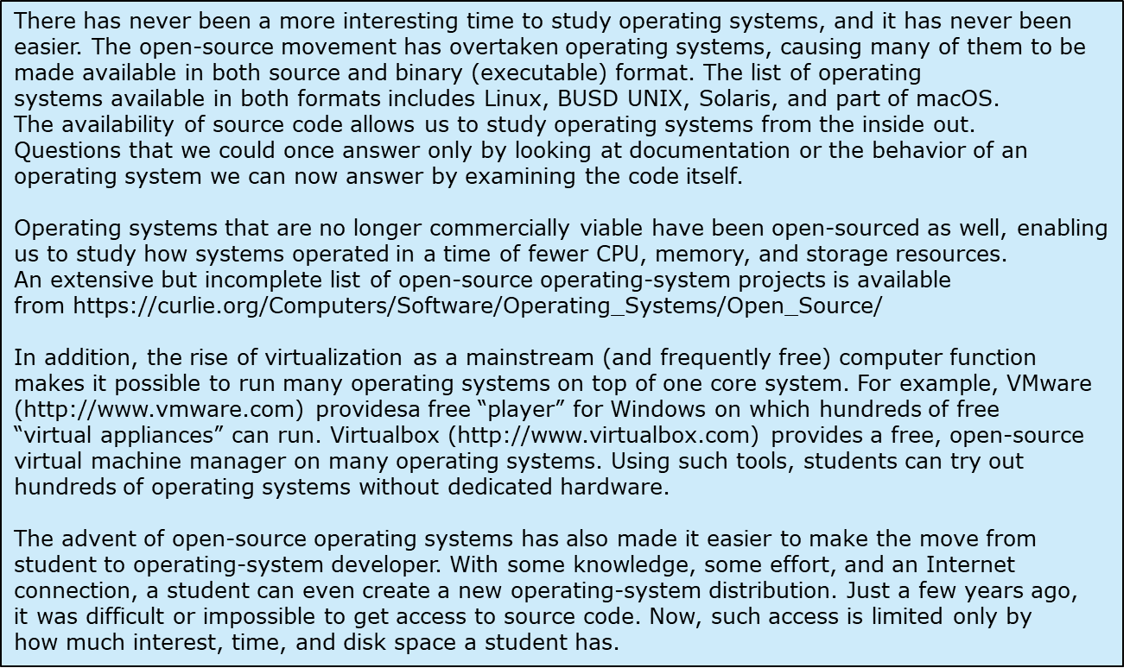
Good time to Study Operating Systems

